Slide 1
IADS Summer School: Day 1. Introduction to the Bayesian Framework
A.D.F. Clarke & A.E. Hughes
1

Slide 2
Intro

Slide 3
The plan for today
Today is mainly theory.
Bayesian and Frequentists
Bayes Theorem
Priors
Bayesian Linear Models
Tomorrow will be more practical.
We will be using the tidyverse and tidybayes packages. We will also need to use rstan, which requires rTools.
Does everybody have these installed?

Slide 4
Who is everybody?
Group introductions:
Who are you?
Why are you here?
What would you like to get out of this two day course?

Slide 5
Bayesian and Frequentists

Slide 6
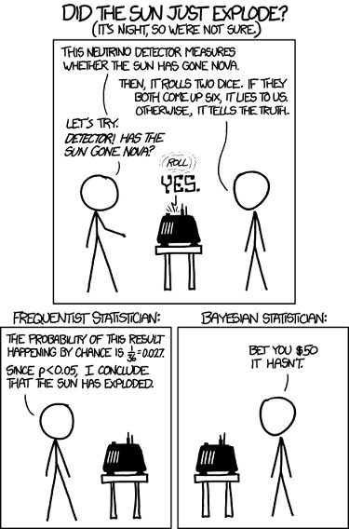
Bayesian Memes for Frequentist Teens
Figure 1: R memes for statistical fiends

Slide 7
Probability interpretations
The frequentist definition of probability is with respect to “the long run” - if we repeat an observation (experiment) multiple times, how often do we observe event A.
The probability of rolling a 6 on a die is 1/6 because if we roll
it enough times, ^{n6} = ¹ .
n 6
Bayesian probabilities are related to uncertainty, evidence, belief, etc.

Slide 8
Probability interpretations
The frequentist definition of probability is with respect to “the long run” - if we repeat an observation (experiment) multiple times, how often do we observe event A.
The probability of rolling a 6 on a die is 1/6 because if we roll
it enough times, ^{n6} = ¹ .
n 6
Bayesian probabilities are related to uncertainty, evidence, belief, etc.
The probability that I am x years old.
The concept of “the long run” doesn’t really apply to cases like this.
Can you think of any other similar examples?

Slide 9
Frequentist Statistics
Frequentist approaches were very popular during the 20th century
Unknown parameters (e.g. mean µ, standard deviation σ) are usually treated as having a fixed, but unknown value.
We use maximum likelihood estimation when model fitting.
Tests of statistical significance lead us to true/false statements.

Slide 10
Bayesian Statistics
Bayesian approaches are older, but as they typically require more computational power, they have only recently become popular.
Parameters are treated as random variables.
Fitting a model involves estimating how likely your parameters are to hold different values.
Less focus on true/false and more on uncertainty. Personally, I feel that this is a far more appropriate framework.

Slide 11
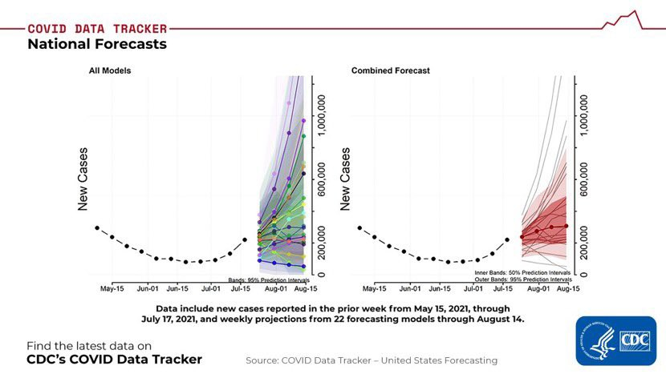
Uncertainty is Important!
Figure 2: Let us hope for the best

Slide 12
Bayes Theorem

Slide 13
Conditional Probability
P(X|Z ) is the probability of X occurring, given:
Z has already occurred.
we assume Z to be true.
Euro 2020 Example:
Before the championship started, England were the favourites:
P(England win) ≈ 17%
After they fail to beat Scotland, the bookies adjust their odds:
P(England win|failed to beat Scotland) ≈ 12%
They somehow managed to beat Germany!?!
P(England|draw v Scotland & win v Germany) ≈ 34%
Aren’t they doing well. . . .
P(England| . . . reached the finals) ≈ 55%
10

Slide 14
Conditional Probability
The formal definition of conditional probability is:
P(A|B) = ^{P(A ∩ B)}
P(B)
The probability of A given B is the probability of A and B divided by the probability of B.
Suppose we roll two dice, d₁ and d₂.
What is P(d₁ + d₂ > 8)?
How about P(d₁ + d₂ > 8|d₁ = 5)?
Now try Q1a and Q1b from the workbook

Slide 15
Conditional Probability
Conditional probabilities are (in general) not commutative
P(A|B) /= P(B|A)
Example: in the last side we worked out P(d₁ + d₂ > 8|d₁ = 5).
Now work out P(d₁ = 5|d₁ + d₂ > 8)
Compare to P(d₁ + d₂ > 8|d₁ = 5) Probabilities can be tricky!
We regularly get these concepts confused
A large P(A|B) does not imply a large P(B|A)!!! (real world implications including DNA evidence, etc)

Slide 16
How to Prove Bayes Theorem
Remember the definition of P(A|B):
P(A|B) = ^{P(A ∩ B)}
P(B)
We can rearrange this to get:
P(A|B)P(B) = P(A ∩ B)
and we can use exactly the same logic to get:
P(B|A)P(A) = P(A ∩ B)

Slide 17
Bayes Theorem
Therefore, we can equate
P(A|B)P(B) = P(B|A)P(A)
and finally apply some simple algebra to arrive at:
_{P(A|B) =} P(B|A)P(A)
P(B)
You now know how to prove Bayes Theorem!

Slide 18
Why is this useful for statistical inference?
Suppose we have a hypothesis (model), H, and some data, D.
What we usually want to know is P(H|D), how likely is our hypothesis to be true given the data that we have observed.
Sadly, this is usually hard to work out directly. Consider the example:
Out of 100 dice, 1 is loaded and rolls a 6 half of the time.
Suppose we select a die at random and roll a 6.
What is the probability that we have rolled the loaded die?
We will denote this hypothesis H_{L}.
We want to know P(H|D) =, but calculating this is hard!
P(H_{L}|6) =???

Slide 19
Bayes Theorem Example
Writing out the definition of conditional probability doesn’t help:
P(H_{L}|6) = ^{P(HL ∪ 6)}
P(6)
But, applying Bayes’ Theorem helps us get somewhere!!!
_{P(HL|6) =} P(6|H_{L})P(H_{L})
P(6)
Now all we have to do is to calculate P(6|H_{L}), P(H_{L}) and P(6) individually.

Slide 20
Bayes Theorem Example
Calculating each part:
P(6|H_{L}) = ¹ = 0.5
2
P(H) = P(H_{L}) = ¹ = 0.01
100
The only tricky part is P(6):
P(6) = P(H_{f} )P(6|H_{f} ) + P(H_{L})P(6) = ⁹⁹ ¹ + ¹ ¹ = 0.17
100 6 100 2

Slide 21
Bayes Theorem Example
Hence:
_{P(HL|6) =} P(6|H_{L})P(H_{L})
P(6)
₌ 0.5 × 0.01 ₌ 0.01 _{≈ 0.03}
0.17 0.0047
There is a 97% chance that we are rolling a fair die.
Exercise: what happens if we roll three 6s in a row? Exercise: How many 6s do we have to roll in row before we are confident that the die is loaded?

Slide 22
Priors

Slide 23
What is a prior belief?
_{P(H|D) =} P(D|H)P(H)
P(D)
P(H|D) ≈ P(D|H)P(H)
P(H|D) is our posterior probability: how likely is our hypothesis given the data?
P(D|H) is the likelihood: how likely is the data, if we assume the hypothesis is true?
P(H) is our prior probability for our hypothesis: how likely do we think it is, before we look at the data. -> a distribution you (informed but) subjectively state as what you assume data WILL look like. (slide 26)

Slide 24
Flat priors
A flat or uninformative prior is when we assume everything is equally likely.
The frequentist models that you may have used previously are equivalent to a Bayesian model with a flat prior (kind of).
We can nearly always do better than this!
And it isn’t as hard as you might think.

Slide 25
Why are flat priors bad?
A flat prior says that you believe that the answer is as likely to be 0 as it is to be 10¹⁰⁰.
This seems unreasonable, as 10¹⁰⁰ is a very large number. It’s many times more than the estimated number of atoms in the entire universe.
A flat prior also states that you believe that a negative answer is as likely as a positive answer. This is often an unreasonable assumption.
Can you think of any examples?
Because of the above -> idea is to always give some parameters to the computer in terms of what we would expect from data (e.g., we know weight will very unlikely/never be negative… or likely)

Slide 26
Informative Priors
We can often estimate our priors from the literature, every day experience, and best guesses.
To specify an informative prior, we need to define how likely every possible answer is. In practice, we often use a normal distribution to do this: x ∼ N(µ, σ) e.g., by setting a confidence interval of e.g., 95% -> saying that average expected height is 170, and that we are 95% confidence the actual answer will fall between 150 and 200 = tells us about the SD. If you are more certain/informed on probability, can make that range 160-180… whole idea is: does not matter if numbers are wrong or even the distribution is wrong 1) start somewhere and 2) if you are not as sure about the exact values make the distribution wider
Exercise: What is your prior for the height of my brother? (our prior knowledge = looking at Alasdair, or looking up the average height in the UK, …)
Weakly-Informative Priors: x ∼ N(0, 1) or x ∼ N(0, 10) are commonly used, especially if we first scale and centre our data (more on this tomorrow).

Slide 27
Weakly Informative Priors
Even σ = 0.1 can be good!
tibble(x = seq(-1, 1, 0.01), y = dnorm(x, 0, 0.1)) %>% ggplot(aes(x, y)) + geom_path()
4
3
y
2
1
0
−1.0
−0.5
0.0
x
0.5
1.0

Slide 28
Informative Priors
The confusing part is that we are often seeking to fit a distribution to some data. If we are fitting a normal distribution, we will have to give a prior for µ and σ.
And, the prior for µ is itself a distribution!
This means we have to define a µ_{µ} and σ_{µ}! (see slides 31)
Distributions of distributions! It’s all nested!
Don’t worry if you find this confusing, that’s natural!

Slide 29
Example setting priors

Slide 30
Exercise: Students at a UK University
One approach is to “guesstimate.”
We will assume that we can model the number of students at different universities using a normal distribution
Even is this is wrong, idea is that you start SOMEwhere, and then improve
0.4
0.3
0.2
0.1
0.0
y
x

Slide 31
Exercise: Students at a UK University
To define a normal distribution, we need two numbers. . . µ and σ.
If we are going to do some Bayesian analysis, we need to specify a prior for each of these prior parameters.
prior for µ ∼ N (µ_{m}, σ_{m}) e.g., = ‘how likely will it be for an average value to have a certain value’
we will discuss the prior for σ later. e.g., = ‘how likely will it be for variance between number of unistudents to have a certain value’
You can think of µ_{m} as our best guess of what the answer will be. The σ_{m} value indicates how much uncertainty we have about that guess. The larger it is, the more uncertain we are about what the answer will be.
Split into break-out rooms and come up with a prior for µ.

Slide 32
Alasdair’s Answer
There are around 300 UG students in each year for psychology.
So around 1000 students in total.
If there are ≈ 10 departments at Essex, that gives us 10,000 students
Essex is a relatively small university, so let’s set µ = 15, 000
If I set σ = 2500, that gives me a likely range of µ = 10k-20k

Slide 33
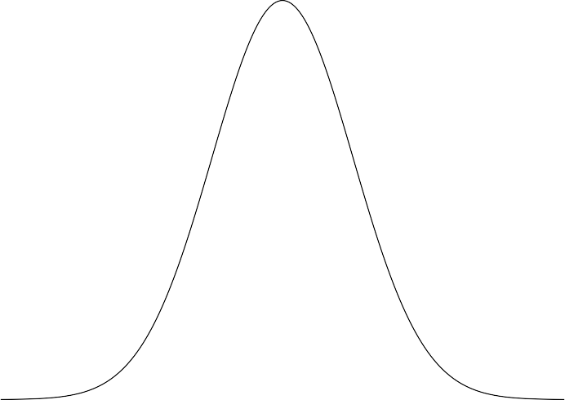
Alasdair’s Answer
0.00015 0.00010 0.00005 0.00000
 | 5000 |  | 10000 |  | 15000 Average number of students at UK University |  |  |  | 20000 |  | 25000
y

Slide 34
How about σ
We now need to give a prior for the standard deviation, σ.
By definition, σ > 0, so narrows down the range quite a bit.
One simple distribution that we can use is a Uniform distribution: σ ∼ U(0, σ_{max}) refers to a type of probability distribution in which all outcomes are equally likely.
A useful rule-of-thumb is to remember that 95% of probability density of a normal distribution lies between ±1.96 SD around the mean (I am lazy and use ±2.)

Slide 35
Estimating σ
If µ = 15, 000, what range around this seems sensible?
σ = 5000 means that we expect 95% of universities to have between 5000 and 25000 students.
Is this plausible?
So perhaps σ ∼ U(0, 10000) is reasonable? Can you think of any problems?

Slide 36
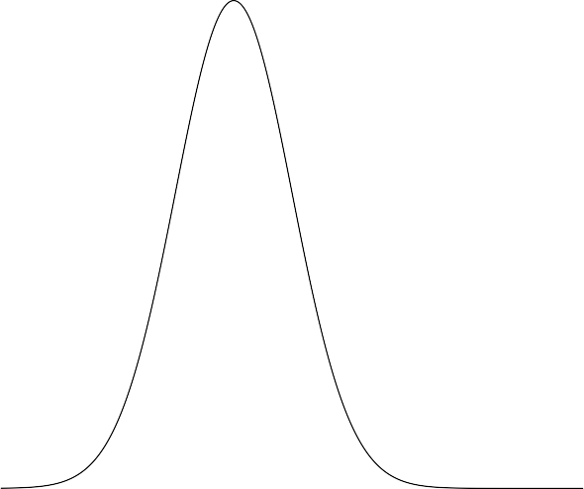
Comparing my prior of the mean to some datapoints
0.00015 0.00010 0.00005 0.00000 |  |  |  |  |  |  |  |  |  |  |  | university 2018/19 Mean Aberystwyth Essex Manchester Oxford
 |  |  | 10000 |  | 20000 Average number of students at UK University |  |  |  |  | 30000
y
(no, I didn’t cheat)
31

Slide 37
Prior Predictions
We can combine our µ and σ priors to give us some predictions!
n <- 10
mus <- rnorm(n, 15000, 2500)
sigmas <- runif(n, 2500, 7500) x <- seq(0, 50000)
d <- tibble(iter = as.numeric(),
x = as.numeric(), y = as.numeric())
tibble = creating a dataframe but from the tiddyvers package
32

Slide 38
Prior Predictions
We can combine our µ and σ priors to give us some predictions!
for (ii in 1:n) {
d %>% add_row(iter = ii,
x = x,
y = dnorm(x, mus[ii], sigmas[ii])) -> d
}
print(d)
## # A tibble: 500,010 x 3
##
## <dbl> <dbl> ## 1
## 2
## 3
## 4
y
<dbl>
iter x
1
1
1
1
0 0.000000139
1 0.000000139
2 0.000000139
3 0.000000139
33

Slide 39
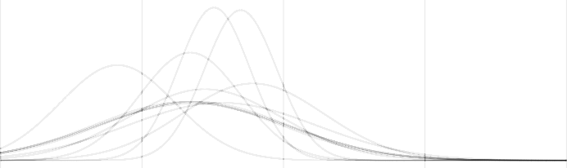
Prior Predictions
We can combine our µ and σ priors to give us some predictions!
ggplot(d, aes(x, y, group = iter)) +
geom_path(alpha = 0.25) + theme_bw() + xlim(0, 40000)
0.00015
0.00010
y
0.00005
0.00000
0
10000
20000
x
30000
40000

Slide 40
A guesstimating challenge
How many caterpillars do you think are eaten by blue tits in the UK every year? (Have a think about this without Google!)
What information do you need to know to be able to make a good guess?
How confident are you about your prediction?

Slide 41
From Prior to Posterior

Slide 42
University of Essex Table Tennis Team
Suppose we want to estimate the chance that the university’s (men’s) table tennis team win their next match.
What would make a good prior? Probability of win vs lose
Before we think about this, we should ask ourselves:
What distribution do we want to use to describe the data?

Slide 43
Distributions and Priors
In the previous example (number of students) we were trying to describe the data using a normal distribution.
How many parameters does it take to define a normal distribution? -> 2
In this example, we want to model binary data (win/loss), so a
binomial distribution is appropriate. Binomial or bernouli -> because 0/1 = loss/win a match
How many parameters does it take to define a binomial distribution? -> 1 = p

Slide 44
A prior for p
For binominal We only have one parameter to worry about: p.
Now we need to define a prior distribution for p (see slide 30 &31). To keep things ‘simple’ we will use a normal distribution. (I would use a beta-distribution if this was my own research.)
To get started, we need to give µ and σ. You can think of µ being our best guess of what the answer (for p’s value) is, while σ represents our uncertainty about this guess.
This isn’t perfect, as N(µ, σ) isn’t bounded by [0, 1].
To fill in these values -> consider What do we know about the University of Essex’s Men’s Table Tennis Team?

Slide 45
Weakly Informative Prior
For the mean, µ:
I know next to nothing about them, so I’ll set µ = 0.5.
I.e., p = 0.5 is the my best guess! (for our prior binominal)
For the standard deviation, σ:
p < 0 and p > 1 are impossible!
I don’t think it is likely that they win (or lose) nearly every game. So p = 0.5 seems more likely than p < 0.1 or p > 0.9.
But I wouldn’t be shocked if our table tennis team was really good (p = 0.9) or really bad (p = 0.1).
We want to think about ALL the possible values, and decide which seem plausible, and which seem surprising.

Slide 46
My prior
Taking a normal distribution and setting µ = 0.5 and σ = 0.1:
tibble(p = seq(0, 1, 0.01), prior = dnorm(p, 0.5 , 0.1)) %>% ggplot(aes(x = p, y = prior)) + geom_path()
4
3
prior
2
1
0
0.00
0.25
0.50
p
0.75
1.00

Slide 47
My prior
Increasing σ to 0.2:
2.0
1.5
y
1.0
0.5
0.0
0.00
0.25
0.50
p
0.75
1.00
41

Slide 48
Grid Approximation
We will cover two different ways of calculating the posterior from your data and your prior:
Grid approximation: estimate what the posterior probability of
p = x is for a set number of different x (i.e.,
x ∈ {0, 0.1, 0.2 . . . , 0.9, 1.0}).
MCMC: “magically’ ’ estimate a load of samples from the posterior (more on this next week)
Let’s enter our grid values,:
d <- tibble(p = seq(0, 1, 0.05))
42

Slide 49
Important Super Useful Tip about seq()
unique(d$p) # all unique values in p, column in d
## [1] 0.00 0.05 0.10 0.15 0.20 0.25 0.30 0.35 0.40 0.45 0.50 0
## [16] 0.75 0.80 0.85 0.90 0.95 1.00
filter(d, p == 0.3)
## # A tibble: 0 x 1
## # ... with 1 variable: p <dbl>
d[4,]
## # A tibble: 1 x 1 ## p
## <dbl> ## 1 0.15
d[4,]$p == 0.15
## [1] FALSE
43

Slide 50
Computers aren’t good at representing numbers!
You can get more info on this with ?1==1.
We can get the behaivour we expect using all.equal(): all.equal(d[4,]$p, 0.15)
## [1] TRUE

Slide 51
Computing the prior probabilities
Now that we have defined our grid, we can compute the prior probabilities for each point on it.
d %>% mutate(prior = dnorm(p, 0.5, 0.2)) -> d
ggplot(d, aes(x = p, y = prior)) + geom_path(colour = 1purple1, size = 2)
2.0
1.5
prior
1.0
0.5
0.0
0.00
0.25
0.50
p
0.75
1.00

Slide 52
Let’s look at some data
They won their first game (against Queen Mary’s)!
We would like Pr (p = x|W ) = How likely are we to win the next match given our previous wins’ but we can’t estimate this directly. So instead we work out the likelihood Pr (W |p = x ). How likely is it to win given a p value (with p value here = probability of winning the next match)
Pr (w|p = 0) = no chance at winning
Pr (w|p = 0.1) =10%
Pr (w|p = 0.2) =
The code is quite simple:
d %>% mutate(
l1 = dbinom(1, 1, p)) -> d

Slide 53
Let’s look at some dataK
## # A tibble: 21 x 3
## | p | prior | l1
## | <dbl> | <dbl> | <dbl>
## | 1 0 | 0.0876 | 0
## | 2 0.05 | 0.159 | 0.05
## | 3 0.1 | 0.270 | 0.1
## | 4 0.15 | 0.431 | 0.15
## | 5 0.2 | 0.648 | 0.2
## | 6 0.25 | 0.913 | 0.25
## | 7 0.3 | 1.21 | 0.3
## | 8 0.35 | 1.51 | 0.35
## | 9 0.4 | 1.76 | 0.4
## | 10 0.45 | 1.93 | 0.45
## # ... with 11 more rows

Slide 54
Plotting the likelihood
2.0
1.5
probability density
1.0
0.5
0.0
0.00
0.25
0.50
p
0.75
1.00
Orange = likelihood calculated from an event 1 happening at value p

Slide 55
Computing the posterior
We can’t just use the likelihood, Pr (w|p = x ), this wouldn’t make much sense. - Can you think why?
We can use Bayes Theorem to combine the likelihood with our prior:
d %>% mutate(
post1 = prior * l1,
post1 = length(post1) * post1/sum(post1)) -> d

Slide 56
Computing the posterior
## # A tibble: 21 x 4
## | p | prior | l1 | post1
## | <dbl> | <dbl> | <dbl> | <dbl>
## | 1 0 | 0.0876 | 0 | 0
## | 2 0.05 | 0.159 | 0.05 | 0.0168
## | 3 0.1 | 0.270 | 0.1 | 0.0572
## | 4 0.15 | 0.431 | 0.15 | 0.137
## | 5 0.2 | 0.648 | 0.2 | 0.274
## | 6 0.25 | 0.913 | 0.25 | 0.484
## | 7 0.3 | 1.21 | 0.3 | 0.769
## | 8 0.35 | 1.51 | 0.35 | 1.12
## | 9 0.4 | 1.76 | 0.4 | 1.49
## | 10 0.45 | 1.93 | 0.45 | 1.84
## # ... with 11 more rows

Slide 57
Plotting posterior
2.0
1.5
probability density
1.0
0.5
0.0
0.00
0.25
0.50
p
0.75
1.00
Purple = prior, probability of winning = of an event happening = of outcome being 1 -> we put this at value p = 0.5 = 50% chance you will win the game green = posterior = prior * likelihood of your observed results/ data in the case here, the event = they won.
Orange = likelyhood

Slide 58
Game Two
Sadly, Essex lost their second game (against Burnel)
Our previous posterior is our new prior - we have updated what we know! Probability of winning was 50/50, but we won our last game, so we have a slightly higher chance of winning the next one. Because winning implies you are good.
OUr likelihood is the same as for Game One.
We calculate the new posterior as before
d %>% mutate(
l2 = dbinom(1, 1, p), post2 = post1 * l2,
post2 = length(post2) * post1/sum(post2)) -> d

Slide 59
Game 2
2.5
2.0
probability density
1.5
1.0
0.5
0.0
0.00
0.25
0.50
p
0.75
1.00
Purple = current prior, but old posterior, probability of winning = outcome being 1 -> was 50% (p=0.5, grey graph), but we updated it based on a previous win, so now p ~ 0.56 green = posterior = prior * likelihood of your observed results/ data in the case here, the event = they LOST. So posterior is now bit to the left of the prior, previously was to the right

Slide 60
Game 3
They managed to beat King’s College!
2
probability density
1
0
0.00
0.25
0.50
p
0.75
1.00

Slide 61
Game 4
Another game against Queen Marys and another win!
2
probability density
1
0
0.00
0.25
0.50
p
0.75
1.00

Slide 62
Game 5
A narrow loss to East Anglia
3
2
probability density
1
0
0.00
0.25
0.50
p
0.75
1.00

Slide 63
Game 6
LSE didn’t show up, that another win!
3
2
probability density
1
0
0.00
0.25
0.50
p
0.75
1.00

Slide 64
Game 7
An easy 14-3 win against Burnel
3
2
probability density
1
0
0.00
0.25
0.50
p
0.75
1.00

Slide 65
Summarising the posterior
Any easy way of working with Bayesian models is to sample from the posterior:
sample_n(d, 5, replace = TRUE, weight = d$post7)
## # A tibble: 5 x 3
## | p prior | post7
## | <dbl> <dbl> | <dbl>
## 1 | 0.7 1.21 | 2.60
## 2 | 0.35 1.51 | 0.475
## 3 | 0.65 1.51 | 3.04
## 4 | 0.5 1.99 | 2.21
## 5 | 0.95 0.159 | 0.0436
59

Slide 66
Summarising the posterior
The tidybayes package has some useufl functions for summarising posteriors:
post <- sample_n(d, 10000, replace = TRUE, weight = d$post
library(tidybayes)
post %>% mean_hdci(p) ## # A tibble: 1 x 6
## p .lower .upper .width .point .interval ## <dbl> <dbl> <dbl> <dbl> <chr> <chr>
## 1 0.611 0.4 0.85 0.95 mean hdci
We can use our posterior to see what likely values for p are:
d %>% select(p, prior, post = "post7") %>% mutate(cdf = cumsum(post)) -> d
60

Slide 67
Conclusions
Grid approximation is simple, but time consuming.
The accuracy of our results is partly determined by the coarseness of our grid. - You can revisit this example using a finer grid in the workbook
We rarely use grid approximation for more complex problems, but it is useful to run through once or twice to build intuition about Bayesian analysis.
61

Slide 68
Bayesian Linear Models

Slide 69
Mathematical Outline
y ∼ N(µ, σ)
µ = β₁x + β₀
But now, instead of finding the best fit, we will estimate how likely every possibly fit is, (given the data).
We now have three parameters to define priors for: β₁, β₀ and σ.
62

Slide 70
An abstact example
Suppose we want to fit a linear model to some data. We have two variables, x , and y .
Here are some example points:
## # A tibble: 21 x 2
## |  | x | y
## |  | <dbl> | <dbl>
## | 1 | -10 | 24.1
## | 2 | -9 | 24.0
## | 3 | -8 | 22.5
## | 4 | -7 | 17.3
## | 5 | -6 | 28.3
## | 6 | -5 | 14.6
## | 7 | -4 | 11.3
## | 8 | -3 | 23.4
## | 9 | -2 | 13.1
63
## 10
-1 9.55

Slide 71
Chosing priors when you know very little
However, we nearly always know something about the scale of the data (and if we don’t, we could always rescale the data before modelling!).
Think about the data you plan to collect yourself. . . is it reasonable to assume that you know the approximate scale ahead of time? Are your numbers going to be between 0 and 1. Or perhaps you are measuring reaction time in ms.
In the data on the last slide, the y values seemed to be around about 10. Give or take.
We can also check what the range of the x values are, as this is our indep. variable.
## [1] -10 -9 -8 -7 -6 -5 -4 -3 -2 -1 0 1 2 3 4 5 6 7 8
## [20] 9 10

Slide 72
Some weak priors
We should probably use some weakly-informative priors.
N(0, 10) for β₀ seems reasonable: when x = 0, we think y is likely to be between -20 and 20. We often don’t rarely care too much about the intercept.
N(0, 1) for β₁ is a good choice for the slope. A value of 0 varying between -1 and 1 says that we expect the slope to be shallow, and allows us to be conservative. We would need a lot of data to convince is that the slope was 100!
For σ, we will use U(0, 10) (uniform distribution)
Let’s sample some values from these priors to see what type of relationship between x and y we are assuming.

Slide 73
Prior Predictions
n_iter = 1000
beta0 <- rnorm(n_iter, mean = 0, sd = 10) beta1 <- rnorm(n_iter, mean = 0, sd = 1) sigma <- runif(n_iter, min = 0, max = 10)
x <- seq(-10, 10, 0.1)
n <- length(x)
y <- rep(x, n_iter) * rep(beta1, each = n) + rep(beta0, each = n)
d <- tibble(
x = rep(x, n_iter), y = y,
r = rep(1:n_iter, each = n))

Slide 74
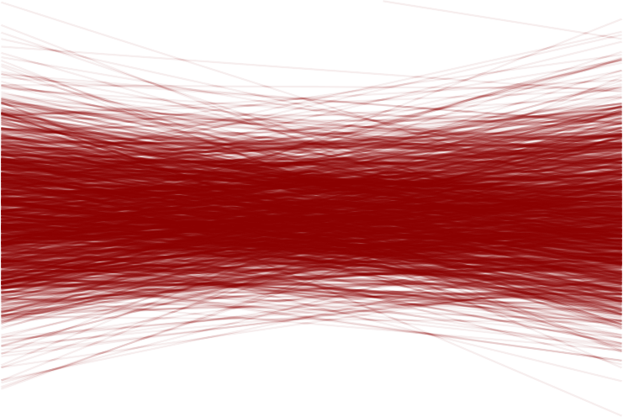
100 Prior Predictions - β₀ and β₁
## Warning: Removed 123 row(s) containing missing values (
50
25
y
0
−25
−50
−10
−5
0
x
5
10

Slide 75
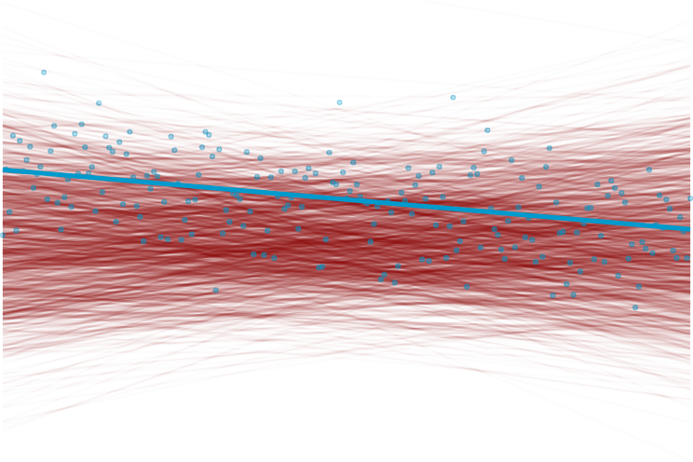
Prior Predictions - an example of σ = each of these lines has a spread, shown here is that fo one line.
## Warning: Removed 123 row(s) containing missing values (
50
25
y
0
−25
−50
−10
−5
0
x
5
10

Slide 76
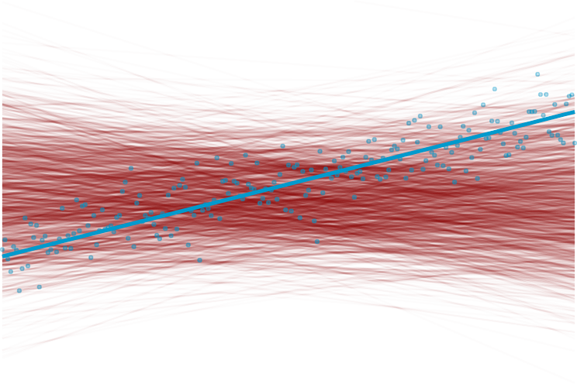
Prior Predictions - an example of σ
## Warning: Removed 123 row(s) containing missing values (
50
25
y
0
−25
−50
−10
−5
0
x
5
10

Slide 77
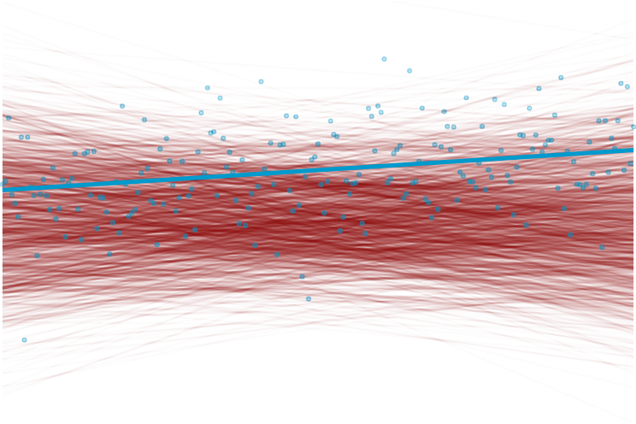
Prior Predictions - an example of σ
## Warning: Removed 123 row(s) containing missing values (
50
25
y
0
−25
−50
−10
−5
0
x
5
10

Slide 78
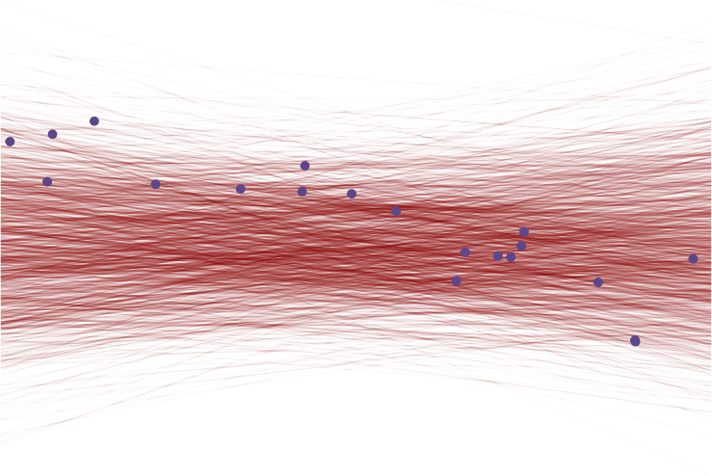
## Warning: Removed 123 row(s) containing missing values (
Now we introduce some data
50
25
y
0
−25
−50
−10
−5
0
x
5
10

Slide 79
Fitting a Bayesian linear model
In the table tennis (binomial) example, we only have one parameter to estimate. In this example, we now have three: β0, β1, σ.
In the table tennis example, we knew that our parameter, p was between 0 and 1, and we calculated the posterior values for equally spaced 11 values.
In this example, our parameters are no longer bounded, and even if we only tested 11 values per parameter, we would still have
11 × 11 × 11 = 1331 values to test!
You can imagine how this quickly becomes unwieldy!
Luckily, Anna will be going over a more powerful method next week!
Today, we will simply compute the posterior probability of each of our 100 samples from our prior.
72

Slide 80
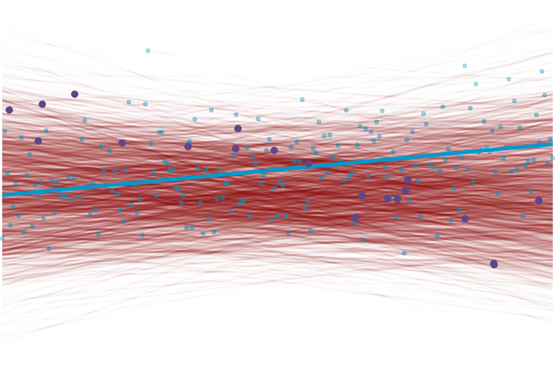
p(H | D)
50
25
y
0
−25
−50
−10
−5
0
x
5
10

Slide 81
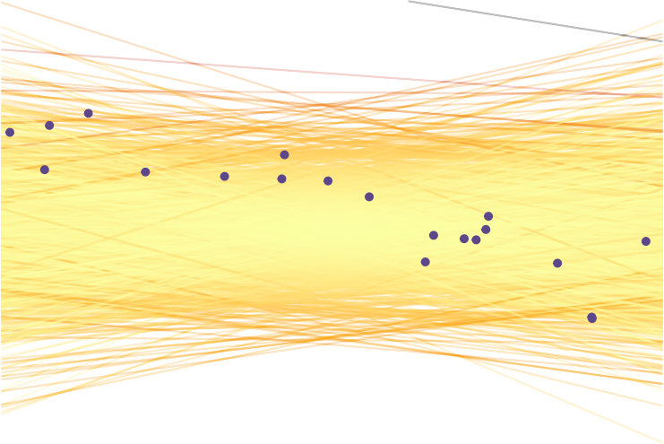
p(H_{i} ) - prior
50
25
y
0
−25
−50
−10
−5
0
x
5
10

Slide 82
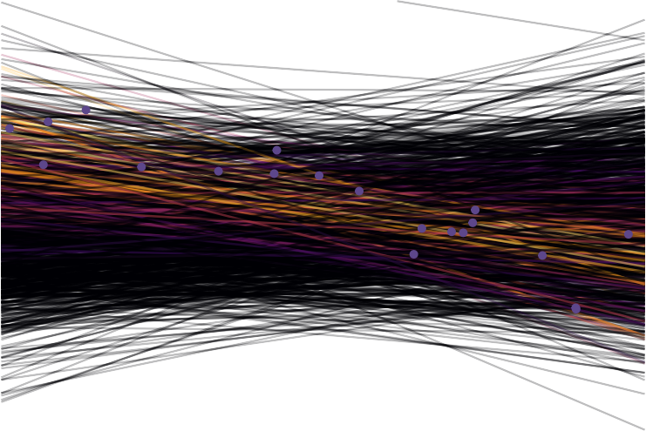
p(D|H_{i} )
50
25
y
0
−25
−50
−10
−5
0
x
5
10

Slide 83
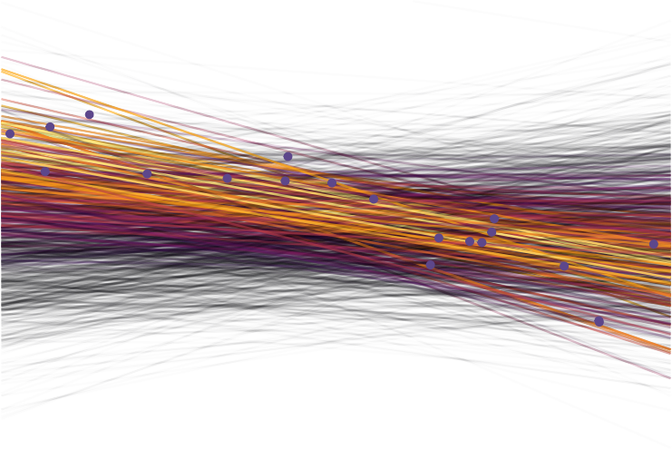
p(D|H_{i} )
50
25
y
0
−25
−50
−10
−5
0
x
5
10

Slide 84
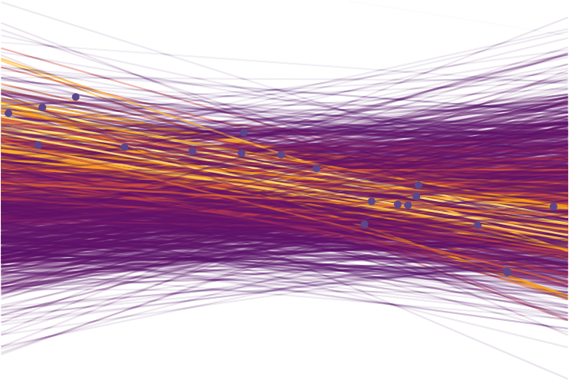
p(H_{i}|D)
50
25
y
0
−25
−50
−10
−5
0
x
5
10

Slide 85
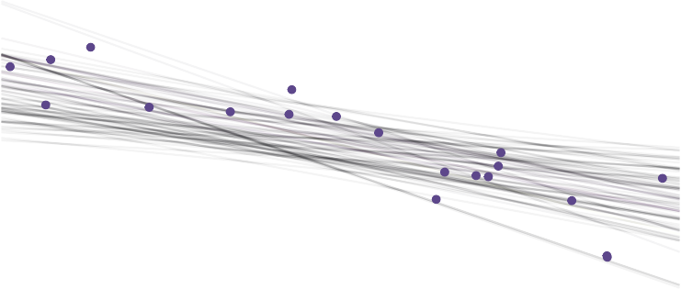
Summarising your posterior
We will take the top 10% of the lines we tested.
50
25
y
0
−25
−50
78
−10
−5
0
x
5
10

Slide 86
Bayesian Linear Models
How I think of it:
A frequentist lm is the estimated best fit line through your sample.
A Bayesian lm contains all possible lines through your sample, with an estimate of likely each line is to have generated your data.
Tomorrow Anna will cover how to use brms, a very powerful package for fitting Bayesian models.
That’s all for now.
79

